Slide 1

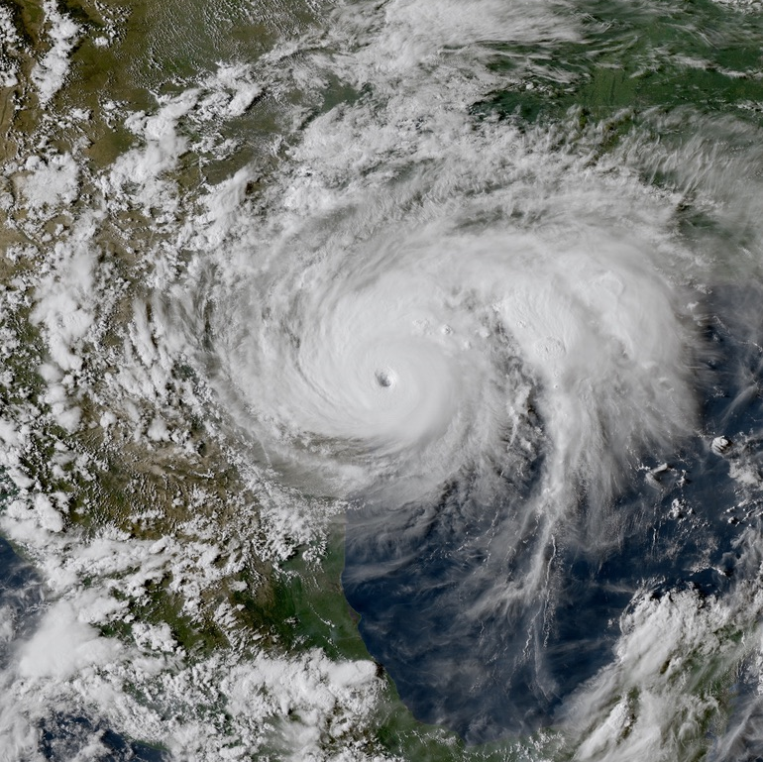
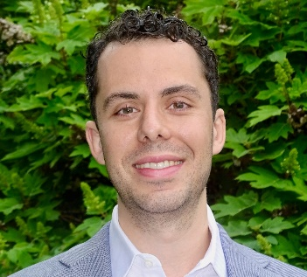
CEVE 543
Data Science for
Climate Risk Assessment
Fall 2023, RICE UNIVERSITY
MWF, 11AM, Keck 107
Delve deep into the world of climate risks through CEVE 543, a project-focused course that will equip you with tools from statistics and machine learning to unravel the complexities of climate risks.
Why it matters
Climate risk estimates shape real-world decisions in engineering design, financial regulation, local zoning, and more. Moreover, a burgeoning job market in climate analytics, climate risk management, and physical risk modeling offers a range of promising career options.
Course organization
Module 1: Fundamentals. Dive into probability, statistics, and machine learning.
Module 2: Downscaling. Link global climate models to local observations and hazards.
Module 3: Frequency Analysis. Quantify the probability of extreme climate risks using Extreme Value Theory.
Module 4: Weather Types. Decode how weather patterns repeat and recur to drive risks on sub-seasonal to seasonal scales.
Engaging projects paired with modules 2-4 will provide context and motivation for specific methods we will develop.
Meet the Instructor
What’s new in 2023?
An Assistant Professor at Rice University's Department of Civil and Environmental Engineering, James Doss-Gollin’s research addresses the intersection of climate dynamics, water management, data science, and decision-making. He also teaches CEVE 521 (Climate Risk Management).
This fall, CEVE 543 weaves together technical lectures, hands-on computational labs, and three projects that illustrate how tools from machine learning and statistics can improve quantitative estimates of climate risks.
For more information visit https://ceve543.github.io

